Slide 1
Training for School Personnel in Administration of Seizure Rescue Medication: Buccal Administration
Developed in accordance to Utah Code 53A-11-603.5 by the Utah Seizure Rescue Medication Task Force A collaborative effort between:
Utah State Department of Health Utah State Board of Education PCH Neurology Department and other stakeholders
Developed in accordance to UCA 53A-11-603.5
by the Utah Seizure Rescue Medication Task Force
A collaborative effort between:
Utah State Department of Health
Utah State Board of Education
PCH Neurology Department
And other stakeholders

Slide 2
This training is designed to:
Provide consistent, state approved training in the administration of seizure rescue medication in a school setting.
Assist licensed medical professionals in training unlicensed assistive personnel to administer seizure rescue medication to a student at school for whom it has been prescribed.
Provide one component of a state approved seizure rescue medication administration training to be used in conjunction with a school nurse lead competency evaluation.

Slide 3
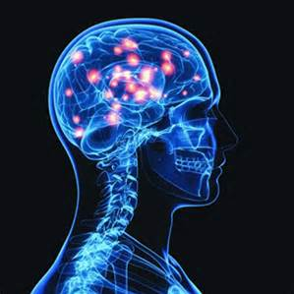
Seizure: Electrical disturbance in the brain.
Most seizures stop without intervention and do not cause any injury.
Some seizures do not stop on their own and without intervention, can lead to permanent brain damage.
Treatment may require administration of emergency seizure rescue medication as prescribed by a medical doctor.
In the case that a student at school needs these medications, certain standards should be followed.

Slide 4
The school nurse, school administration and parent/s must have the following in place before seizure rescue medication can be given in school.
District/School Policy
Signed seizure medication management
order (SMMO)
Approved medication
An Individualized Healthcare Plan (IHP)
Locked storage for medication
Volunteer training
Staff trained in rescue breathing/CPR
See UDOH
“Seizure Rescue Medication Guidelines”

Slide 5
This training describes general guidelines; the Individualized Healthcare Plan (IHP) and the school nurse will describe a student’s:
Type and signs of seizure/s
Prescribed medication
Proper dose and route
When to call 911 and parent
Protocol for AED/CPR

Slide 6
A student at your school has a seizure disorder and has been prescribed BUCCal Medication
Buccal medication comes either as a dissolvable tablet, or a liquid.

Slide 7
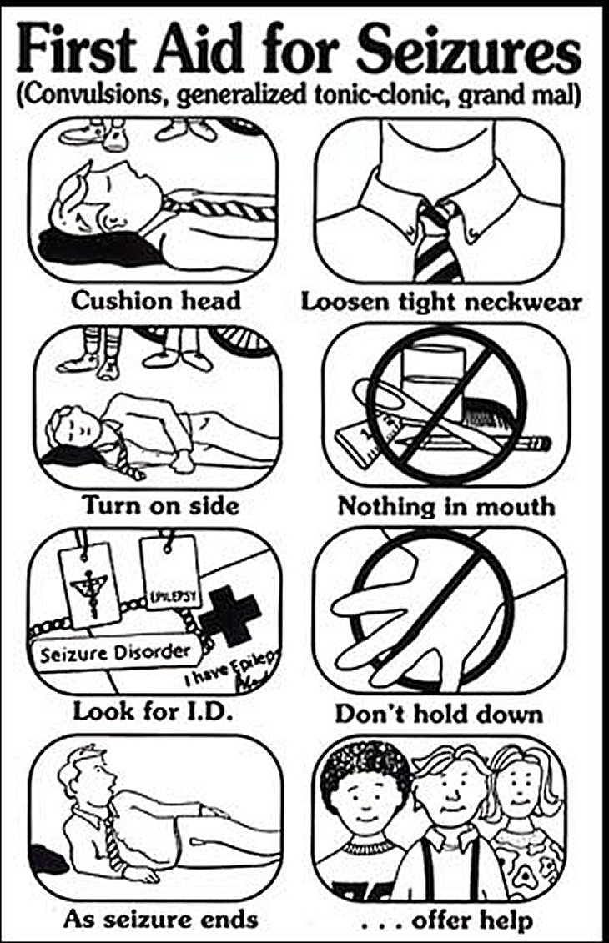
Follow healthcare plan at onset of seizure symptoms:
Time length of seizure.
Follow seizure first aid.
Act calm.
Respect student’s privacy.
If seizure ceases before allotted time to give medication, allow student to recover, and notify parent.

Slide 8
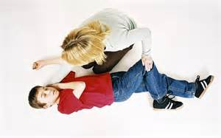
If student meets requirements for
administration of seizure rescue medication
Follow IHP by:
Retrieving appropriate medication
Check that it is for the right student
Check that it is the right time to
give medication
Have someone call 911 and
parents

Slide 9
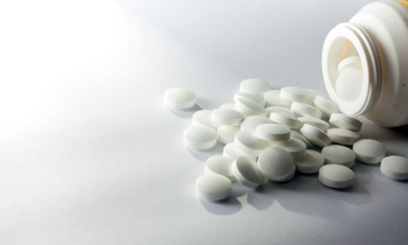
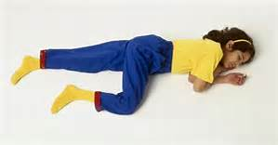
Administration of Buccal Tablet Medication
Put on gloves.
Remove medication from storage area.
Place child in the recovery position.

Slide 10
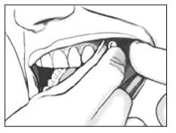
Administration of Buccal Tablet Medication (continued)
4. Dry area between the cheek and gums using a tissue
5. Place the tablet in the mouth between the cheek and gum
6. Gently rub (for about 30 seconds) the outside of the cheek over the area where tablet was placed
7. Keep the student in the recovery position

Slide 11
After administration of any seizure rescue medication and while waiting for EMS:
Follow student’s healthcare plan (IHP).
Assure student is laying on their side (recovery position).
Monitor student’s seizure activity.
Monitor student’s breathing.

Slide 12
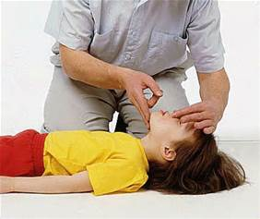
If Breathing Doesn’t Resume After Seizure
Follow healthcare plan and:
Call for AED (Automatic External Defibrillator).
Have trained staff perform CPR with rescue breaths.
Place AED if and when available.

Slide 13
When EMS arrives
If possible, send a copy of healthcare plan including parent contact info with EMS.
Send any empty syringes or containers of medication with EMS.
Report events before, during and after seizure medication was administered.
Document events.

Slide 14
Thank You for Viewing Seizure Rescue Medication Training PowerPoint and Video

